Slide 1
Mini Research Series Week 7 Going beyond the SIR Model
Colin Young
Easyday Education
January 2024

Slide 2
What do we do with the mathematical model for infectious disease?
observe data
develop model
estimate model parameters to fit data
make predictions / assess possible interventions

Slide 3

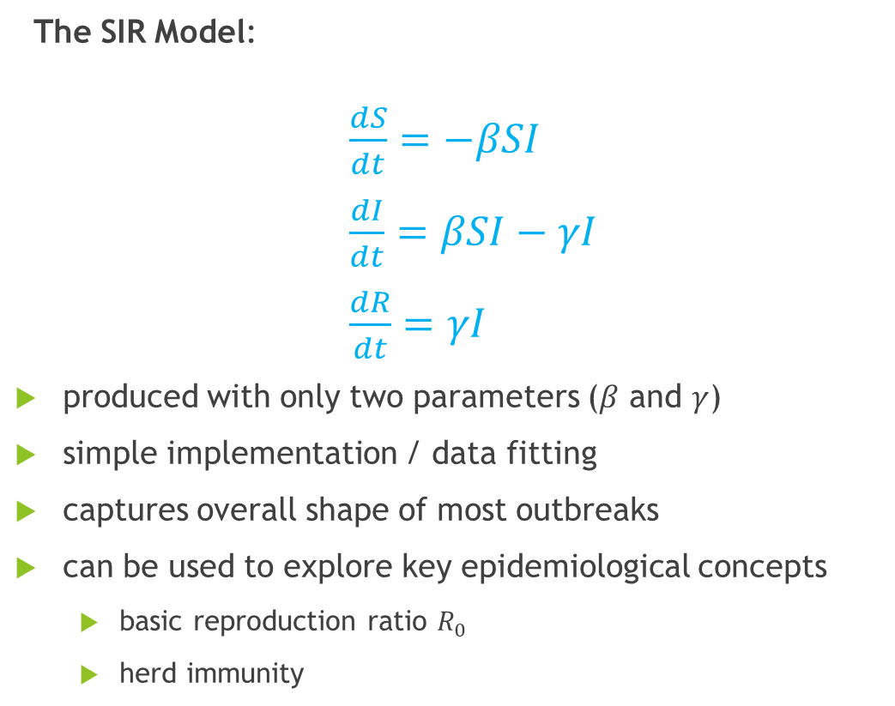

What have we learned so far?
S
$$βSI$$
I
$$γI$$
R
The SIR Model:
$\frac{dS}{dt}=−βSI$
$\frac{dI}{dt}=βSI−γI$
$\frac{dR}{dt}=γI$
produced with only two parameters ($β$ and $γ$)
simple implementation / data fitting
captures overall shape of most outbreaks
can be used to explore key epidemiological concepts
basic reproduction ratio $R_{0}$
herd immunity

Slide 4
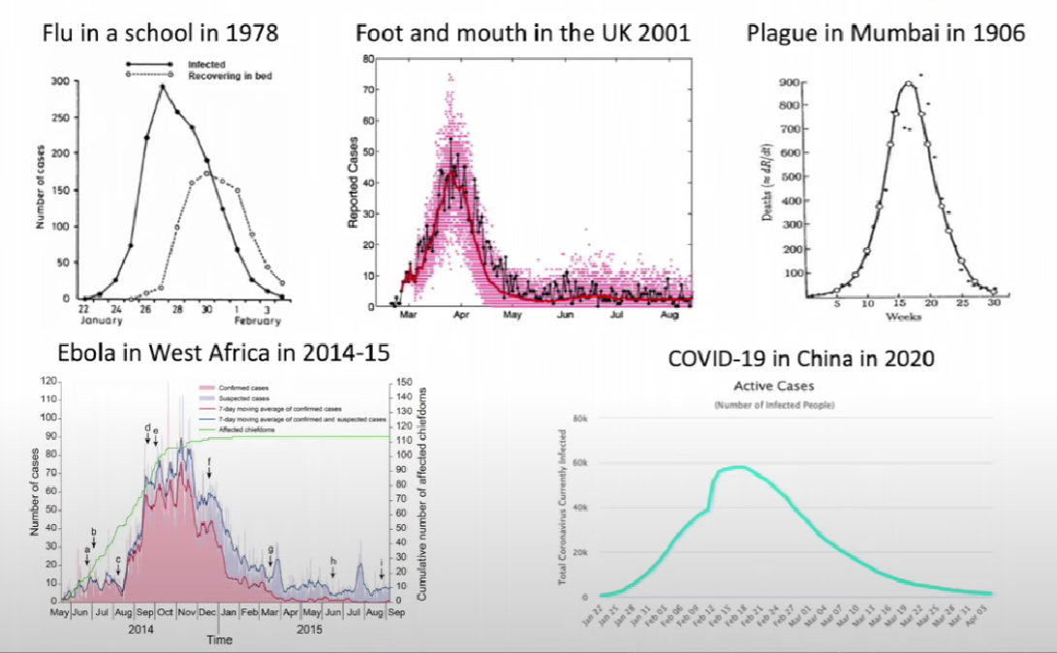
Characteristic shape of outbreaks

Slide 5
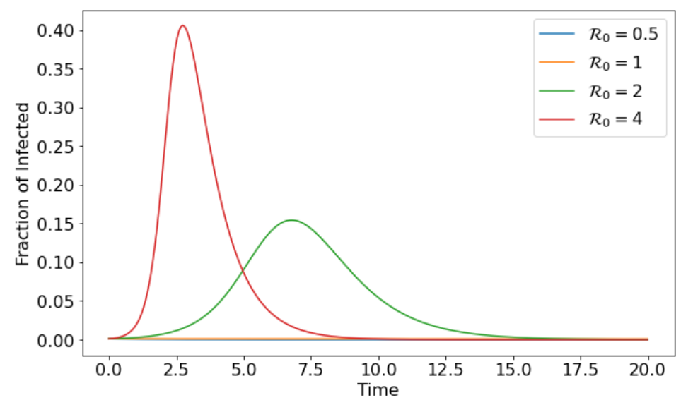
Predictions from the SIR model

Slide 6
Limitations of the SIR model
SIR model is over-simplified in many aspects:
treat every individual as the same
assume any individual becomes immediately infective right after infection
assume everyone mixes with everyone else
assume permanent immunity after recovery
does not consider natural birth/death rates
does not consider possible control policies
…
a lot of ingredients can be added to basic SIR model…

Slide 7
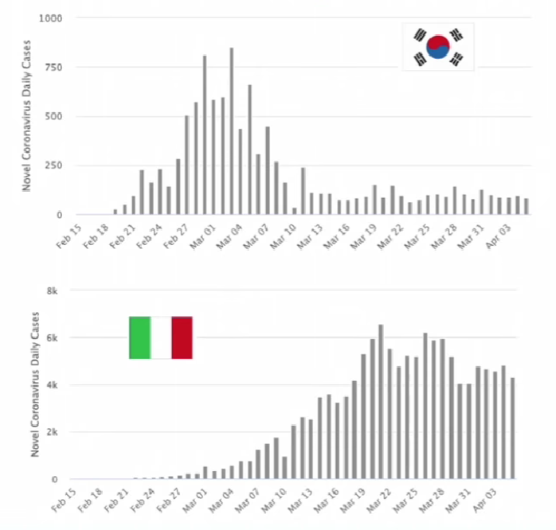
Stochastic SIR Model
idea: infectious disease outbreaks are inherently random

Slide 8
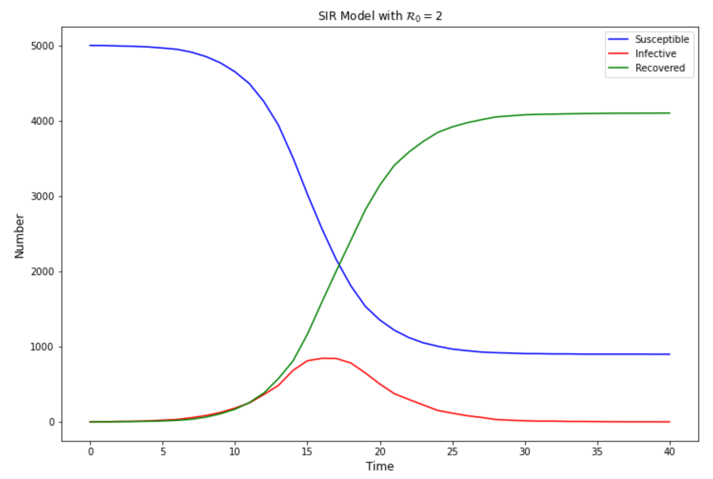
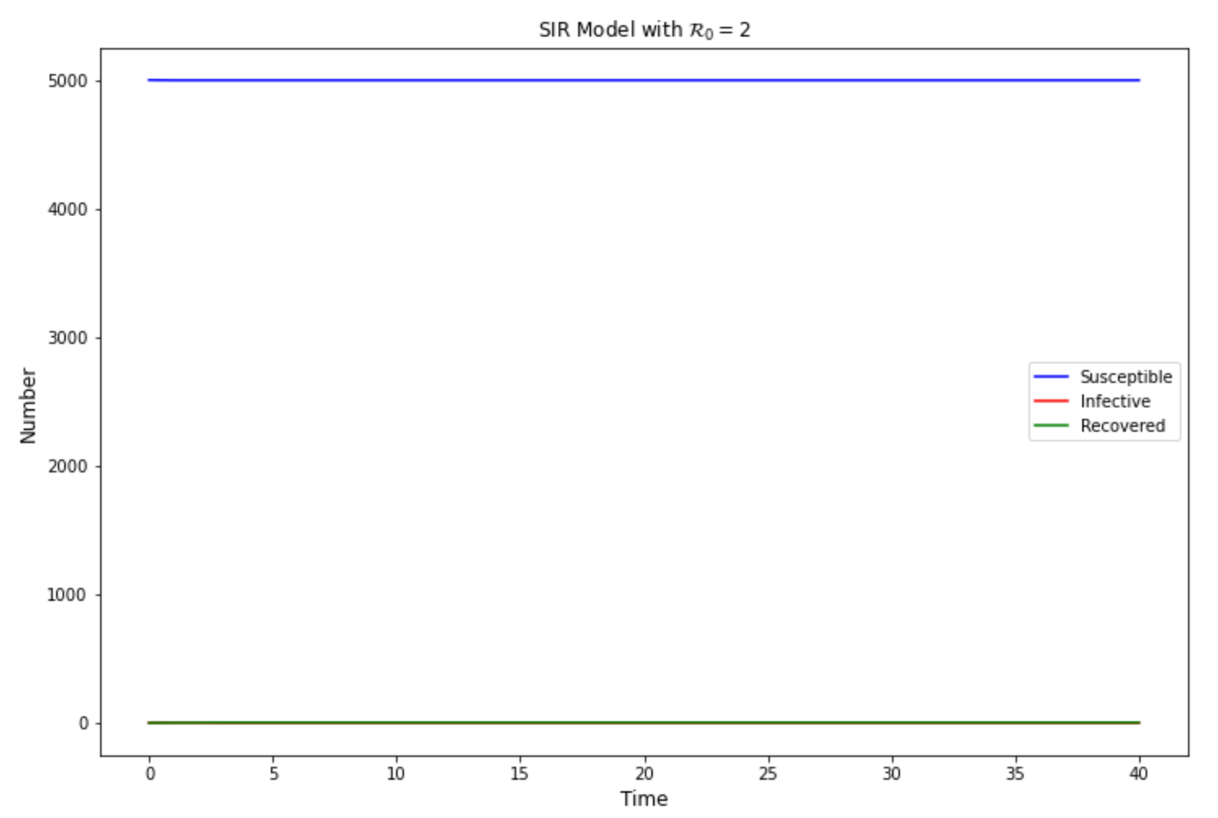
Stochastic SIR Model
how to simulate randomness?
‘flipping coins’ to simulate non-deterministic processes
may produce very different outcomes

Slide 9
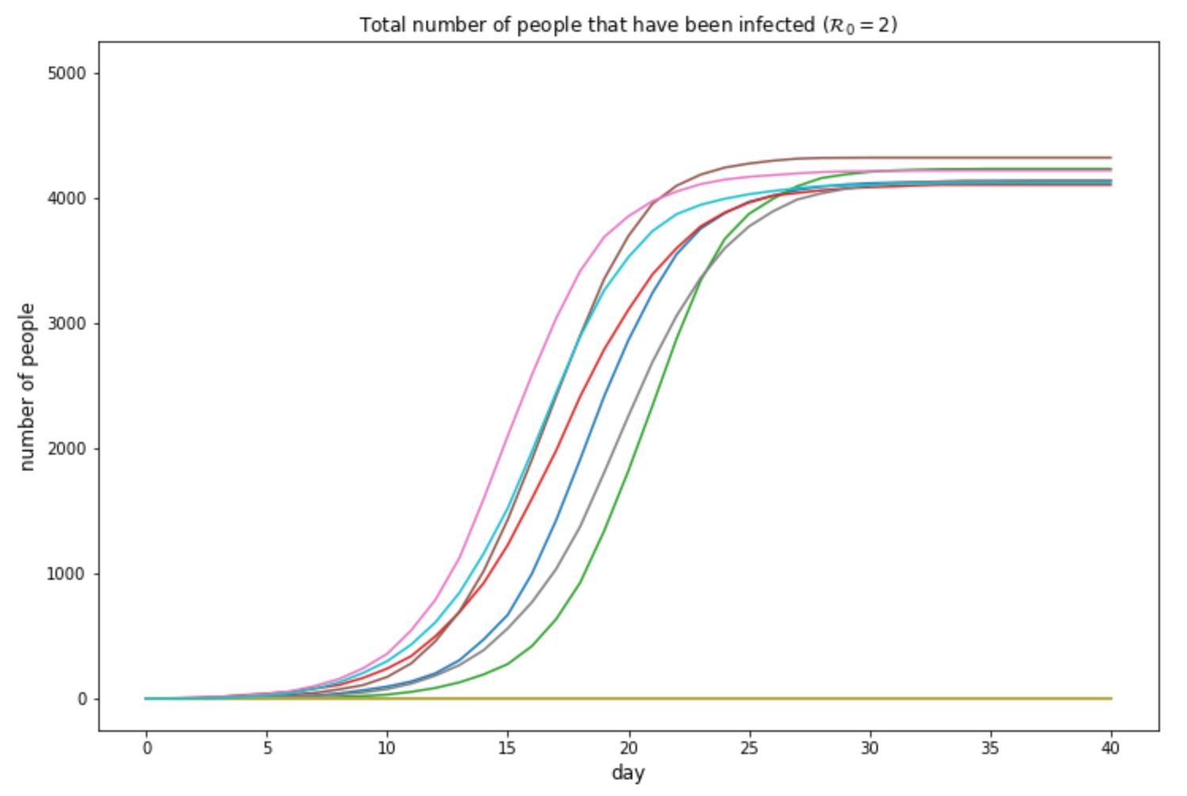
Stochastic SIR Model

Slide 10
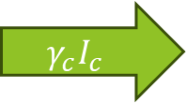
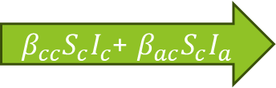


Age Structures
idea: rate of contact between different age groups can be very different
modelling: further divide each compartment into different age groups (e.g. children + adults)
S_{c}
$β_{cc}S_{c}I_{c}$+ $β_{ac}S_{c}I_{a}$
I_{c}
$$γ_{c}I_{c}$$
R_{c}
S_{a}
$β_{ca}S_{a}I_{c}$+ $β_{aa}S_{a}I_{a}$
I_{a}
$$γ_{a}I_{a}$$
R_{a}

Slide 11
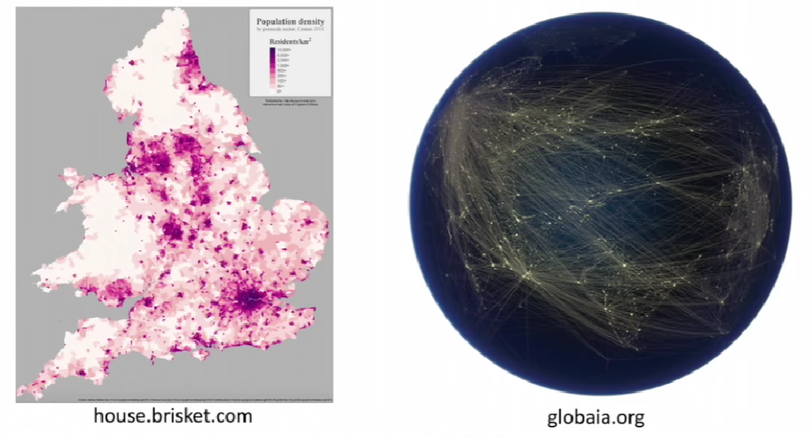
Spatial Structures
idea: rate of contact is different in different regions

Slide 12









Spatial Structures
modelling: introduce regional compartments
region 1
S₁
$$βS_{1}I_{1}$$
I₁
$$γI_{1}$$
R₁
$$λ_{12}$$
region 2
S₂
$$βS_{2}I_{2}$$
I₂
$$γI_{2}$$
R₂
$$λ_{13}$$
$$λ_{23}$$
region 3
S₃
$$βS_{3}I_{3}$$
I₃
$$γI_{3}$$
R₃

Slide 13



SEIR Model
idea: exist incubation period, a delay between when an individual is infected and when this individual starts to show symptoms and become infectious to others
modelling: introduce Exposed (E) group
exposed individuals who have been infected but are not yet infectious
S
E
I
R
$$βSI$$
$$μE$$
$$γI$$

Slide 14


SIS Model
idea: an individual recovered from the disease can be infected for a second time, no permanent immunity
modelling: no recovered group, any individual that is not infectious is essentially susceptible
remark: will have very different fixed-point behaviour compared to the SIR model
S
$$βSI$$
I
$$γI$$

Slide 15
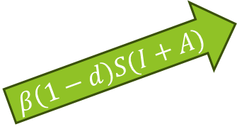


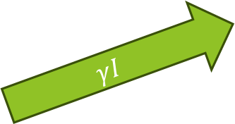
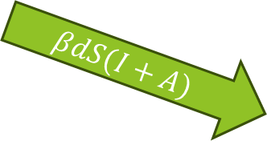
Asymptomatic Transmission
idea: there exists individuals who are infectious but showing few or no symptoms
modelling: introduce Asymptomatic (A) group
$d$ = fraction of infectious cases that show symptoms
$1−d$ = fraction of infectious cases that are asymptomatic
A
$$β\left(1−d\right)S(I+A)$$
$$γA$$
S
R
$$βdS(I+A)$$
$$γI$$
I

Slide 16
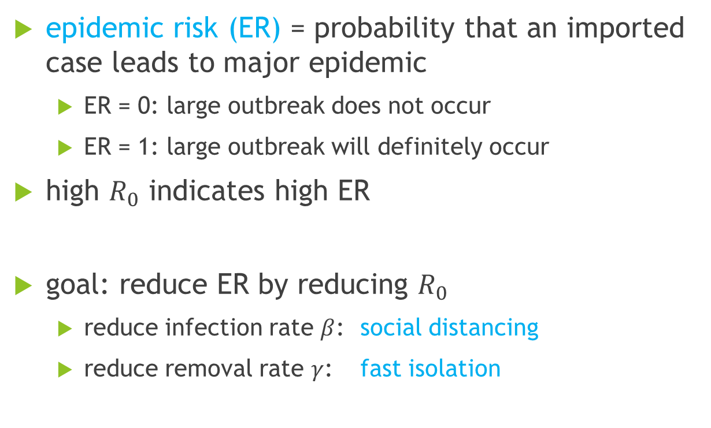
Epidemic Risk (ER)
epidemic risk (ER) = probability that an imported case leads to major epidemic
ER = 0: large outbreak does not occur
ER = 1: large outbreak will definitely occur
high $R_{0}$ indicates high ER
goal: reduce ER by reducing $R_{0}$
reduce infection rate $β$: social distancing
reduce removal rate $γ$: fast isolation

Slide 17
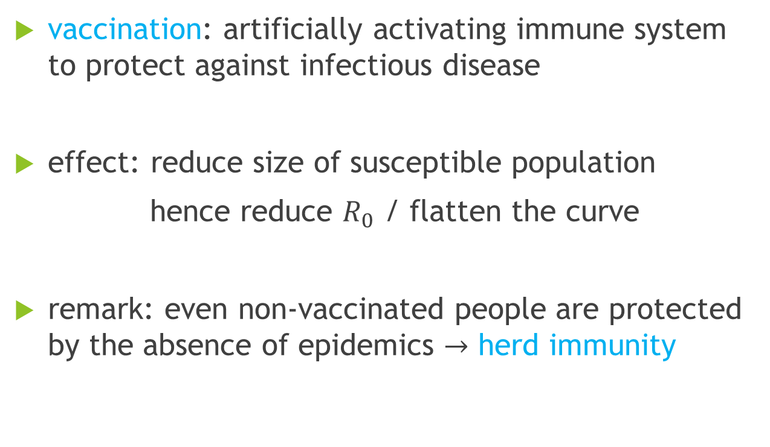
Vaccination
vaccination: artificially activating immune system to protect against infectious disease
effect: reduce size of susceptible population
hence reduce $R_{0}$ / flatten the curve
remark: even non-vaccinated people are protected by the absence of epidemics $→$ herd immunity

Slide 18
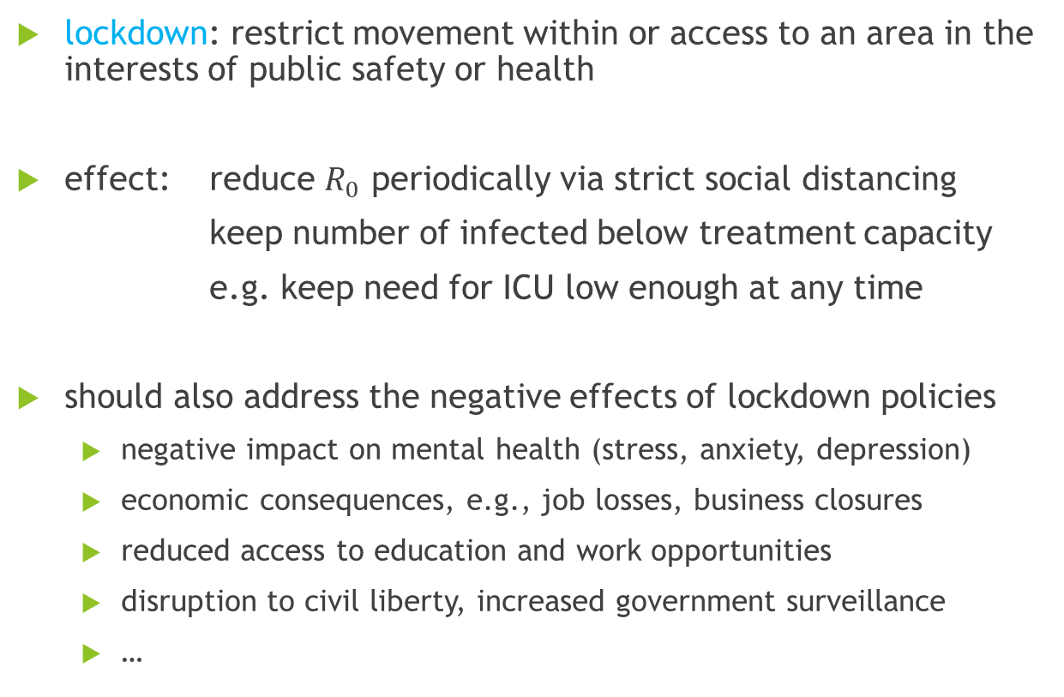
Lockdown Policies
lockdown: restrict movement within or access to an area in the interests of public safety or health
effect: reduce $R_{0}$ periodically via strict social distancing
keep number of infected below treatment capacity
e.g. keep need for ICU low enough at any time
should also address the negative effects of lockdown policies
negative impact on mental health (stress, anxiety, depression)
economic consequences, e.g., job losses, business closures
reduced access to education and work opportunities
disruption to civil liberty, increased government surveillance
…

Slide 19




An Example: the Probabilistic SEQIR Model
entire population is divided into five groups
S = susceptible populations susceptible to the disease
E = exposed infected but still in incubation period
I = infective infected and able to transmit the disease to susceptible
Q = quarantined infected but quarantined (no further contact with others)
R = recovered recovered from the disease / has permanent immunity
update upon each iteration is based on probability
for given initial conditions, run the simulation for multiple times
interpretate the different outcomes
S
$$βSI$$
E
$$μE$$
I
$$γI$$
Q
$$γQ$$
R

Slide 20
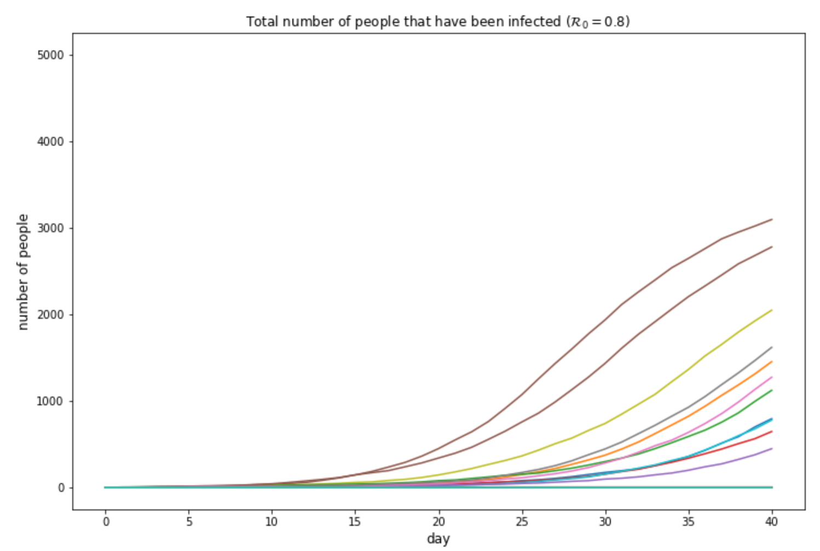
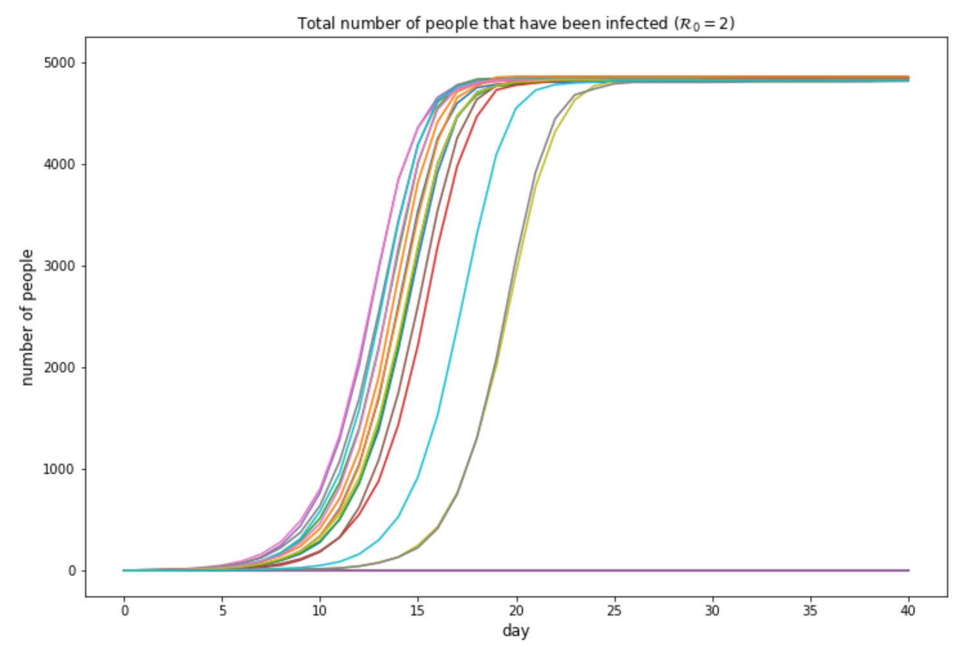
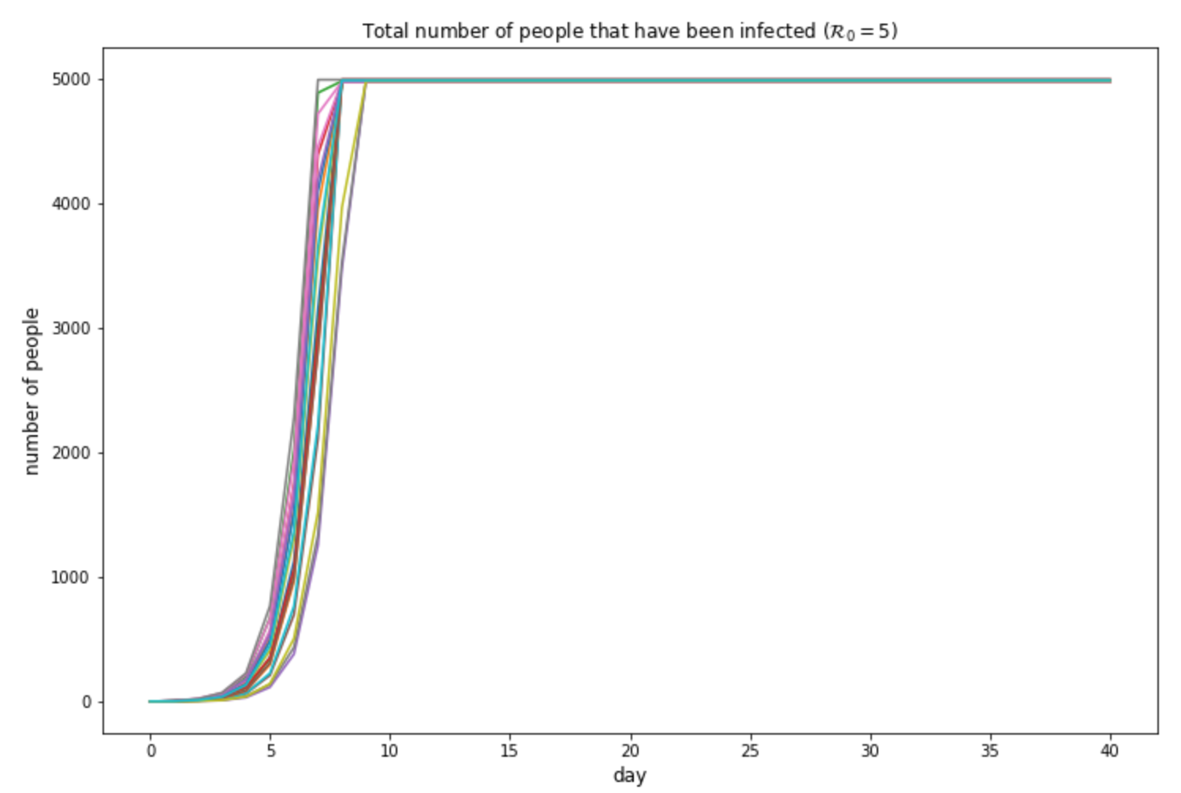
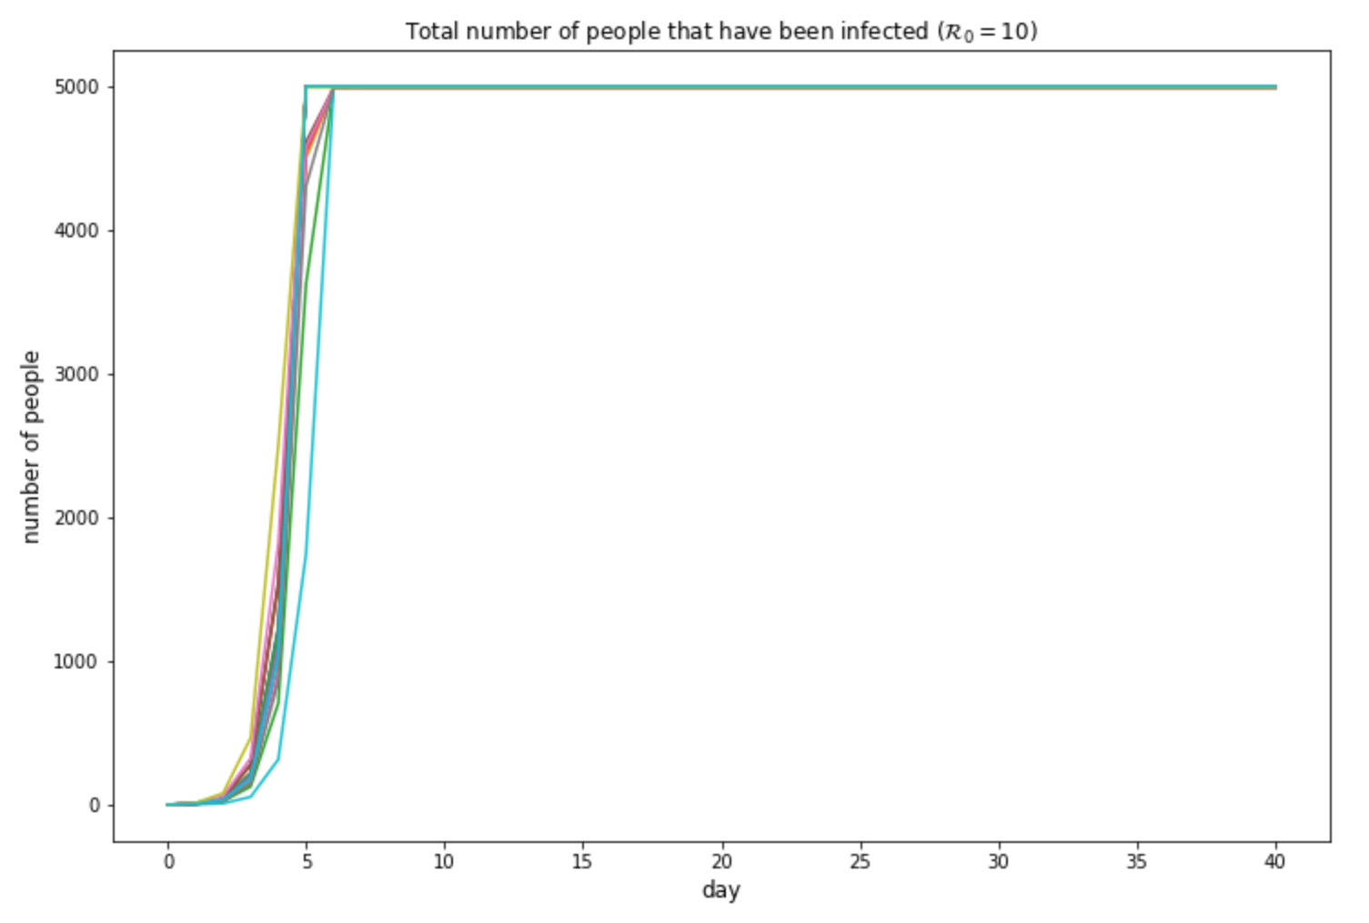
Results: SEQIR without controls

Slide 21
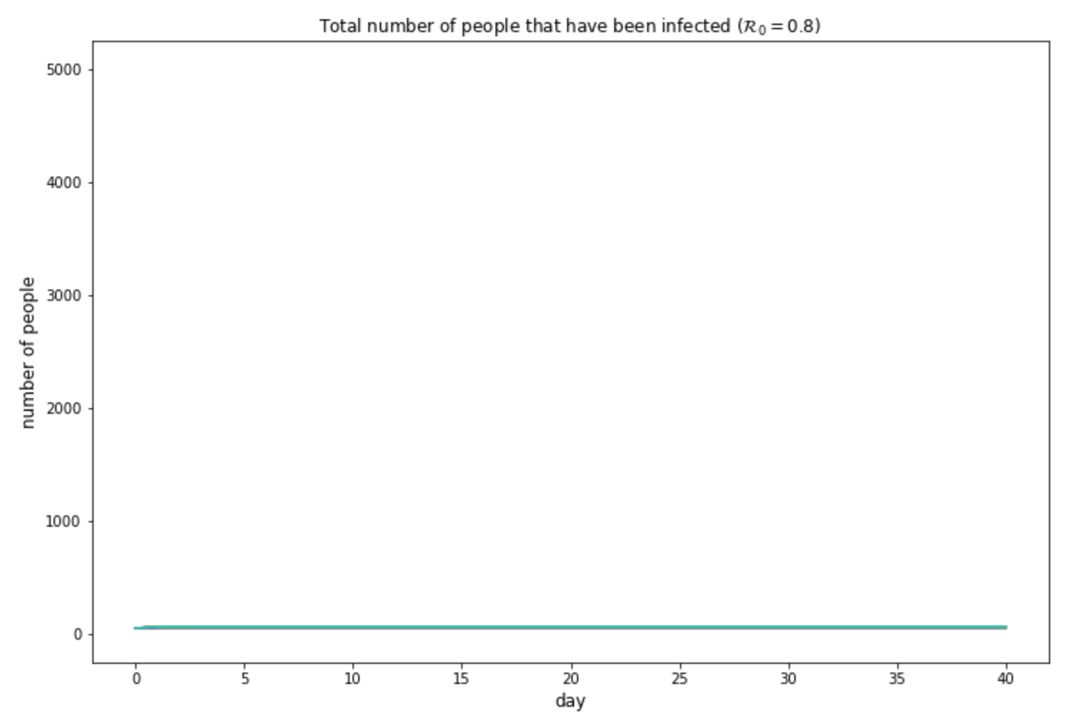
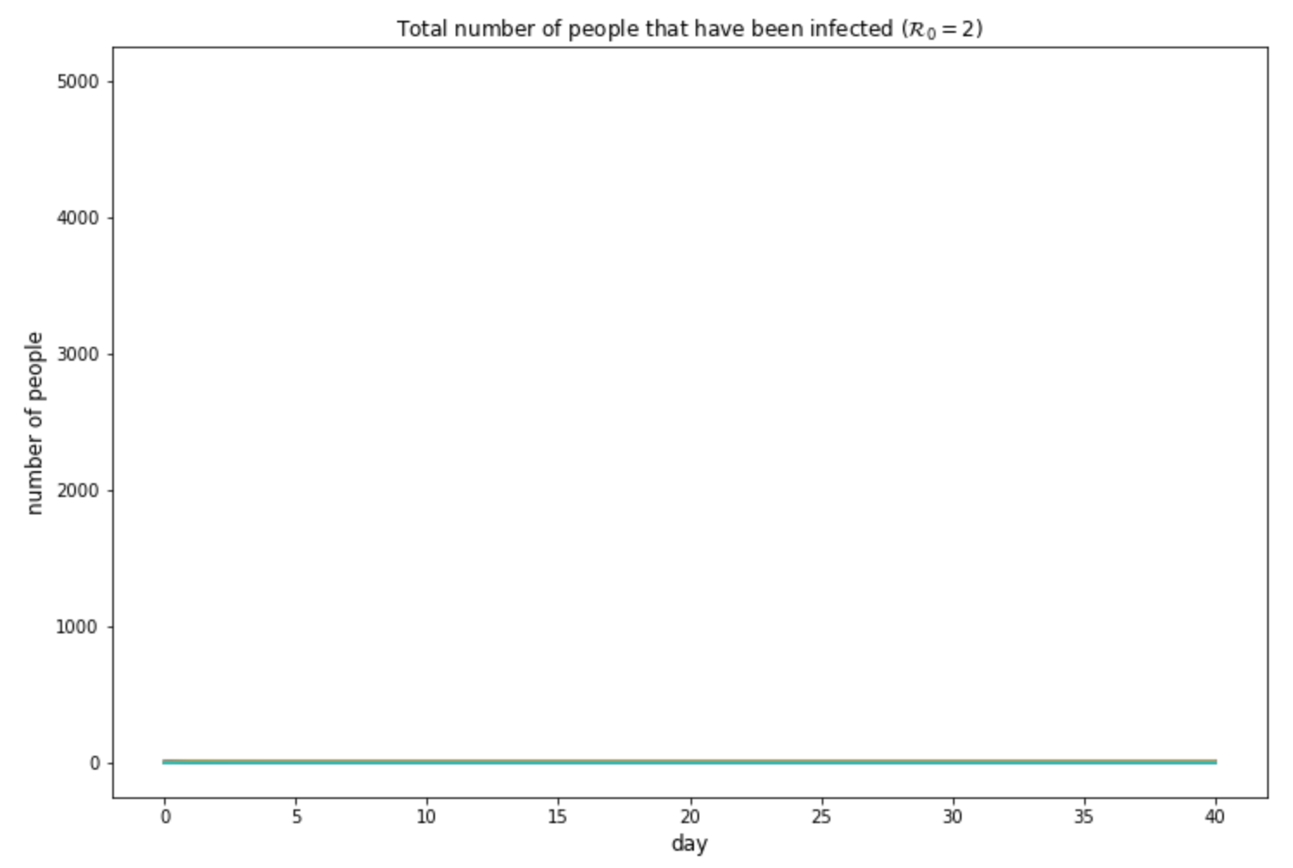
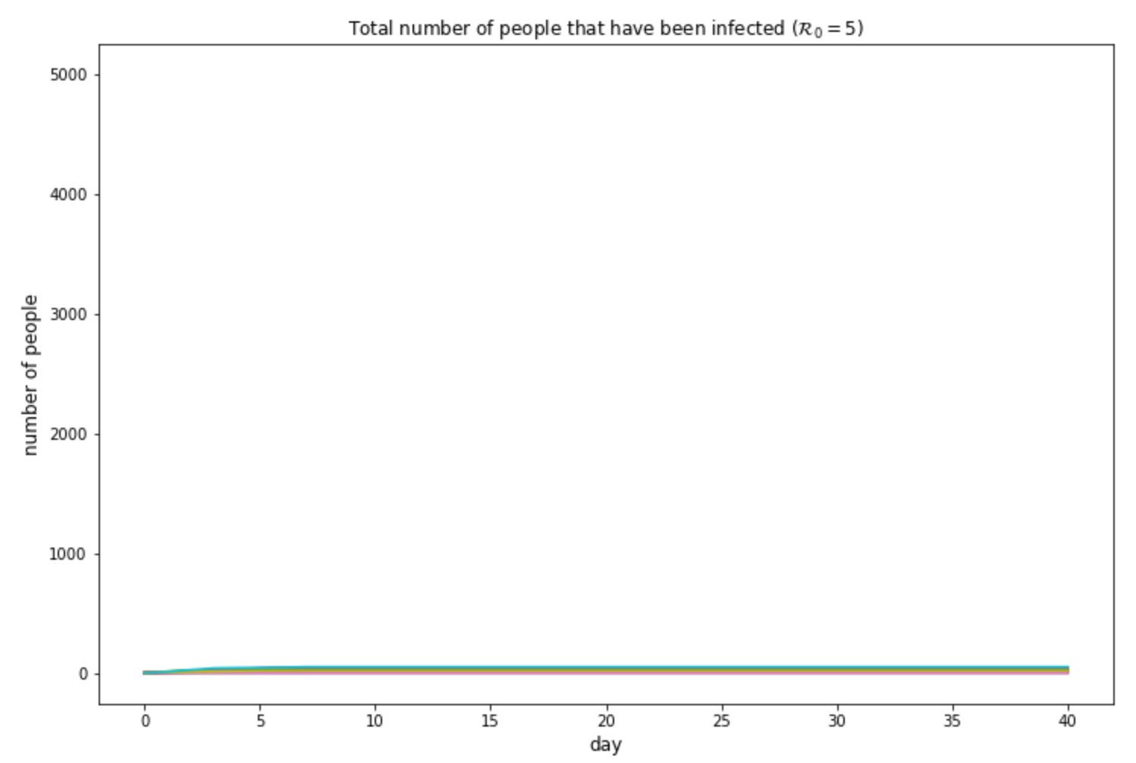
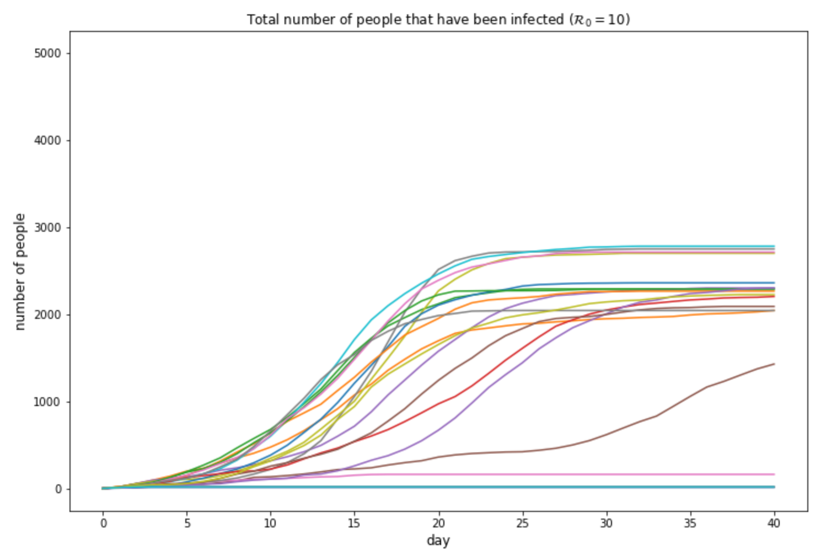
Results: SEQIR with strict controls

